Slide 1
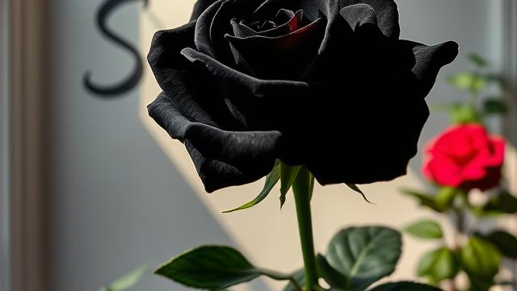
Productive Social Be your most productive self
Ricardo Miambo Junior

Slide 2
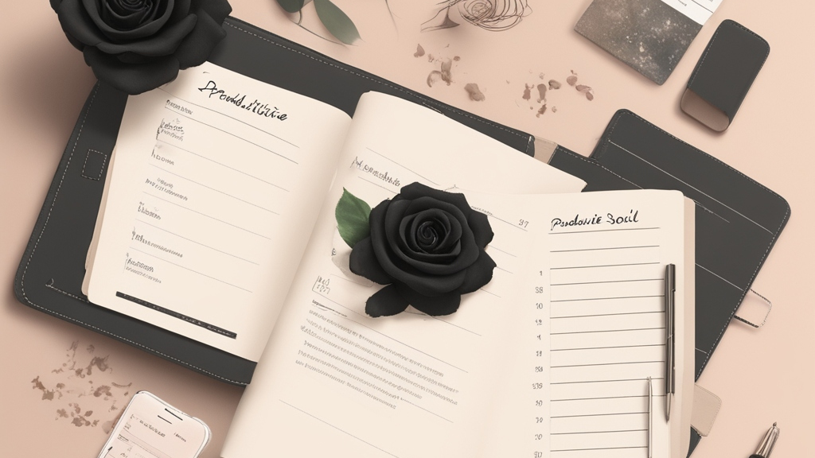
Task management Journaling Calendar & scheduling Communication
A super app for:
Time tracking & Focus Habit building Mindfulness Journaling
All gamified

Slide 3

The problem with top productivity apps for all systems
Notion
Trelio
Forest
Habitica
Diarly
Joplin
Habitify
Promodone
Productive Social aims to replace these apps
With all data combined in one app, PS is guaranteed to produce better performance analyses then the opponents.
They are all isolated in one specific problem they took to solve
Each app generates its own data
Users tend to use more than two apps

Slide 4

What’s unique it’s also the main downfall
To replace a multitude of users preferred apps will be without doubt a nearly impossible task.
While it may be hard to get users to replace their day-to-day apps, PS aims to become a habit in users' daily usage of their smartphones

Slide 5

Social Media and Gamification
By exploring already studied and documented gamification implementations of applications such as Instagram and TikTok, we should be able to keep users returning to PS for all different reasons, eventually users should opt to use all the productive features of PS and these features should drive user retention up.
Users will interact with PS both when they are bored, and when they are productive.

Slide 6
Business Model
B2C
- Free
B2B #TBD

